Slide 1




Final Year Project Presentation
Software Engineering Department
Sir Syed University of Engineering &Technology

Slide 2
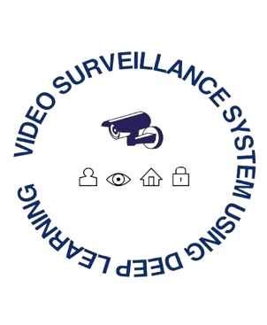
Project Number: 46 Video Surveillance System Using Deep-Learning (Final Year Project)
Supervised by: Dr. Muhammad Asif
(Dean of Faculty )

Slide 3


Team Members & Work Distribution
Adnan Asad (GL)
2020F-BSE-249
Deep Learning
System Design
System Developer
Rida Bhatti
2020F-BSE-217
Mobile Application
Testing
Maham Fatima
2020F-BSE-211
Documentation
Software Development
Eisha Waseem
2020F-BSE-234
Documentation
Software Development

Slide 4

Problem Statement
Develop a video surveillance system using deep learning technology.
Implement object detection and image classification for real-time monitoring.
Enhance system accuracy and efficiency through deep learning models.
Address challenges such as latency Issues, real time-processing, and varying lighting conditions.
Evaluate system performance in terms of detection accuracy and processing speed.

Slide 5
Idea / Solution
Create a video surveillance system that uses deep learning algorithms for object detection and image classification.
Integrate live monitoring features for improved security and surveillance.
Integrate advanced features such as fire, violence and weapons detection with improved accuracy.
Enhance system performance through continuous learning and model optimization.
Provide a user-friendly interface for easy system management and monitoring of surveillance footage.

Slide 6
Scope and Purpose
Scope:
Develop a video surveillance system using deep learning technology.
Implement object detection and image classification for real-time monitoring.
Integrate advanced features such as fire, violence and weapons detection.
Evaluate system performance in terms of accuracy and efficiency.
Purpose:
Enhance security measures through advanced video surveillance capabilities.
Enhance object identification and tracking accuracy using deep learning algorithms.
Offer real-time monitoring and alerting for possible security risks.
Investigate the potential of deep learning in improving video surveillance systems.

Slide 7
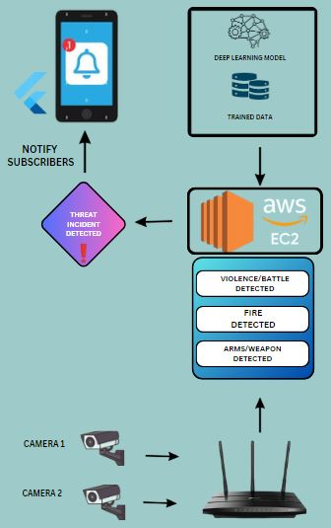
System Diagram

Slide 8
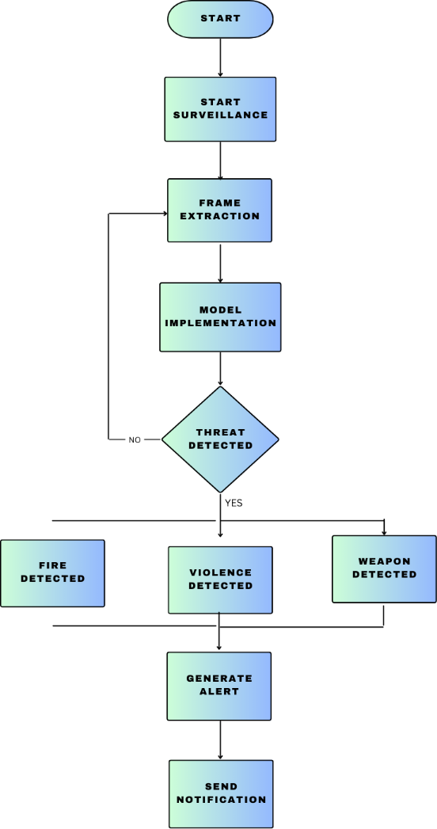
Flow Chart

Slide 9
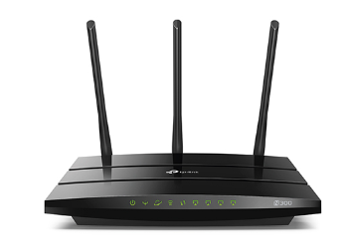
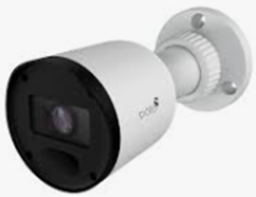




Hardware & Software Components
Camera
WIFI Modem
Python
OpenCV
Flutter
TensorFlow

Slide 10
Methodology
Data Collection:
Source: Kaggle datasets.
Content: Surveillance footage focused on weapons, violence, and fire detection.
Diversity: Includes various environments and conditions for robust model training.
Data Preprocessing:
- Frame Extraction: Videos are split into frames for model input.
- Data Augmentation: Techniques like shuffling, and scaling are applied to enhance data diversity.
Model Training:
Models Used: ResNet-50 for classification, and Faster R-CNN ResNet50 FPN for object detection.
Training: Conducted with supervised learning, optimized through cross-validation and early stopping.
System Integration
Deployment: Camera feed processed in real-time, routed through a modem to an AWS EC2 instance.
Testing: System performance validated through real-world scenarios and metrics evaluation.

Slide 11
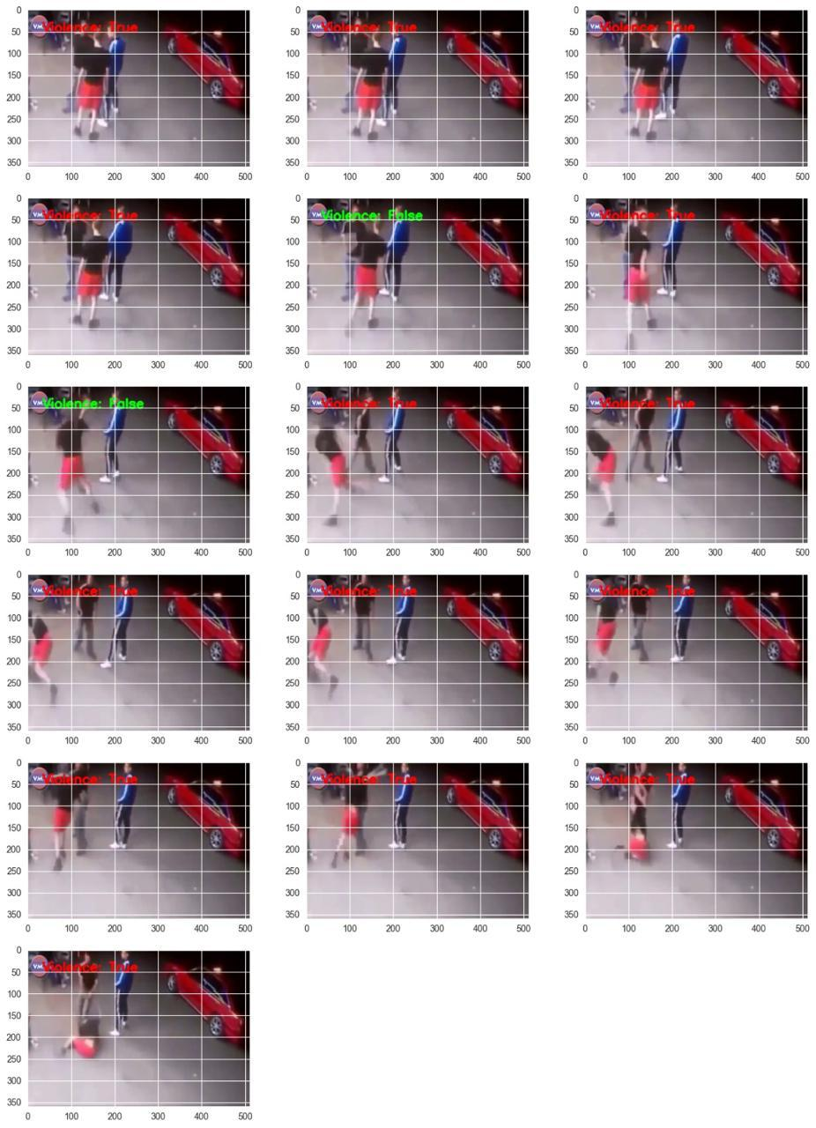
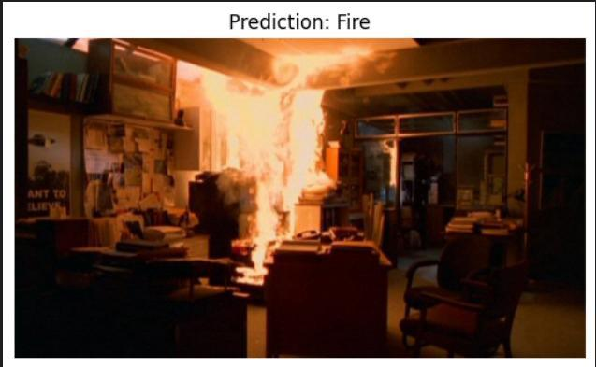
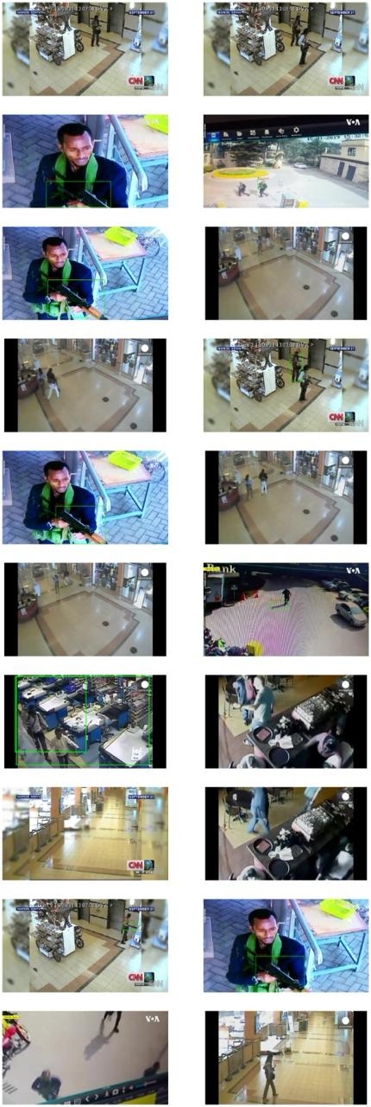
Observation & Results
Violence Detection
Fire Detection
Weapon Detection

Slide 12

Project as Product
Value: Real-time incident detection and alerts.
Partners: Hardware suppliers, AWS, security experts.
Activities: Model training, system setup, maintenance.
Customers: Businesses, security firms, property managers.
Revenue: Subscriptions, setup fees, service contracts.

Slide 13
Business Model
Present the video monitoring system as a software-as-a-service (SaaS) solution with subscription-based pricing.
Supply customization options for various industries and use cases, like retail, transportation, and security.
Implement a tiered pricing model based on the number of cameras and features required.
Offer training and support services for system implementation and maintenance.
Explore partnerships with security companies and integrators for distribution and installation opportunities.

Slide 14
Product Costing
One-Time Costs: Hardware (cameras, modems), development.
Recurring Costs: Cloud services, maintenance, support.
Marketing & Sales: Campaigns, customer acquisition.

Slide 15
Future Scope
Integration of advanced deep learning models for improved object detection.
Implementation of real-time fire, violence and weapons detection algorithms for enhanced security measures.
Incorporation of multi-camera systems for comprehensive surveillance coverage.
Integration of cloud-based storage and processing for scalability and flexibility.
Exploration of edge computing solutions for faster processing and reduced latency in surveillance systems

Slide 16
Conclusion
The application of a video surveillance system using deep learning technology has displayed encouraging outcomes in boosting safety measures through improved object identification and observing abilities. The inclusion of advanced learning formulas has greatly enhanced the precision and effectiveness of the monitoring system, enabling instantaneous identification of irregularities and potential risks. Going ahead, additional exploration and advancement in this field can result in even more intricate and efficient video monitoring systems for different uses in safety and public protection.
THANK YOU

